Slide 1
McKelvey Staff Council Town Hall
March 17th, 2022
2:00pm- Welcome
2:05pm- Dean Aaron Bobick
General Updates
2:20pm- Dr. Karolyn Senter
Habif Health Services Overview
2:30pm- Jessica Wagenseil
Overview of McKelvey DEI
2:40pm- Ariana Jasarevic
Update on DEI Staff Working Group
Promotion for development, coaching, and learning
2:45pm- Becca Gilberg
Sustainable Transportation Overview
2:55pm- Cassie Hage
Office of Sustainability/Green Office Overview

Slide 2
Dean, Aaron Bobick
Updates

Slide 3
New Staff Hires in the Past Year
Thao Chau
Staff Research Scientist, BME
Kaleigh Dickneite
Graduate Program Coordinator, BME
Molly Otten
Communications Specialist, BME
Cleopatra Benos
Graduate Programs and Communications Coordinator, CSE
Maria Sanchez
Undergraduate Coordinator, CSE
Jesi Hempstead
Administrative Coordinator, EECE
Nechelle Jones
Grant & Accounting Coordinator, EECE
Mary McKee
Communications Specialist, ESE
Megan Affolder
Department Administrator, MEMS
Sari Griffin
Assistant Director of Academic &
Student Services, Sever
Denise Andre
Administrative Assistant, Sever
Chris Gearin
Director, Professional Education Operations, Sever
Tamira Meier
Senior Business Manager, Engineering, TLC
Alex Kosuge
Marketing Automation Specialist, Professional Education
Elma Saric
Administrative Assistant, EUGSS
Jackie Thomas
Registrar I, Engineering, EUGSS
Dorcas Ussiri
Graduate Admissions Coordinator, Engineering, GSS
Cindy Fields
Administrative Coordinator III, GSS
Taylor Bevirt
Videographer, Marketing & Communications
Catie Dandridge
Digital Communications Specialist, Engineering,
Strategy, Communications & External Relations
Alex Groves
Systems Engineer I, EIT
Jenn Clemons
Executive Assistant to the Dean, Office of the Dean
Jeanne Beasley
Payroll Coordinator & Finance/Facilities Assistant,
Admin and Finance
Ally Schreiber
Financial Projects Analyst, Administration & Finance

Slide 4
Mental Health Resources

Slide 5
Habif Health and Wellness Center
South 40
Monday - Friday: 8am – 5pm
habif.wustl.edu
Notes:
This is not meant to scare you, it’s only meant to underscore the importance of taking care of yourself throughout your time in law school, and we also want everyone to know what resources are available for WashU students.

Slide 6
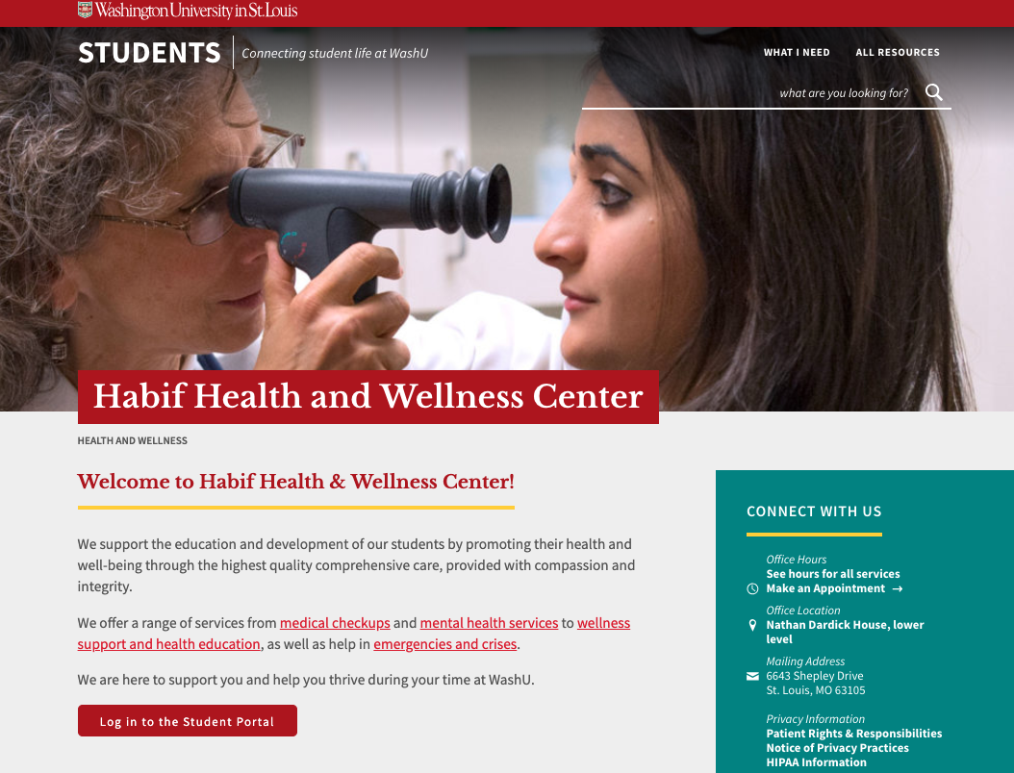
To Schedule a Counseling Initial Consultation:
Call: 314-935-6695
Schedule through the SHS Portal:
https://students.wustl.edu/habif-health-wellness-center/

Slide 7
Individual Counseling
9 free sessions per academic year
45-minute sessions
Typically, sessions are every other week or every 3 weeks
Notes:
Sessions may happen every 3 weeks because of the demand for services.

Slide 8
Treatment Options and Scope of Services
Counseling
Individual
Couples
Psychiatry Services
Groups program
Let’s Talk
Counseling Referral Service
TAO (Therapy Assistance Online)
Online Screenings (Initial Consultations)
Timely Care
Notes:
To access couples counseling – only one member of the couple needs to be a full-time WashU student. So if you have a partner who is not a WashU student, they can come to couples counseling with you.

Slide 9
Free for all WU students with a paid student health fee:
Counseling Sessions
Medical Care
Limited Psychiatry
Health Coaching
Group Sessions
TalkNow – 24/7 after hours support for urgent or emergency concerns
Download the app: https://students.wustl.edu/timelycare/

Slide 10
For Crisis
Monday – Friday, 8 am – 4 pm
Call 314-935-6695 to speak with an on-call counselor
After Hours, evenings, weekends
TalkNow (Available through the Timely Care app)
Notes:
Sessions may happen every 3 weeks because of the demand for services.

Slide 11
Includes over 150 brief, effective, evidence based educational sessions covering over 50 common topics and skills related to mental health
https://students.wustl.edu/therapy-assistance-online/

Slide 12
Spring 2022 Group Therapy Offerings
Https://students.wustl.edu/therapy-group-workshops/
Don’t Mention the Tension (Tuesdays 4:00-5:00 p.m., starting March 8)
Connecting in a Time of Isolation – Graduate and Professional Students (Thursdays 10:00 – 11:30 a.m.)
Dissertation Support Group (Fridays 3:00-4:30 p.m.)
International C.H.A.T. (Tuesdays 3:30-4:50 p.m.)
Lavender Circle (Fridays 3:00-4:30 p.m.)
DBT Skills Workshop Series: Loving Your Emotions – A Beginner’s Guide (Fridays 1:00-3:00 p.m.)
My Not-So-Perfect Family (Wednesdays 10:00-11:30 a.m.)
Understanding Self and Others (Fridays 11:00 a.m. – 12:30 p.m.)

Slide 13
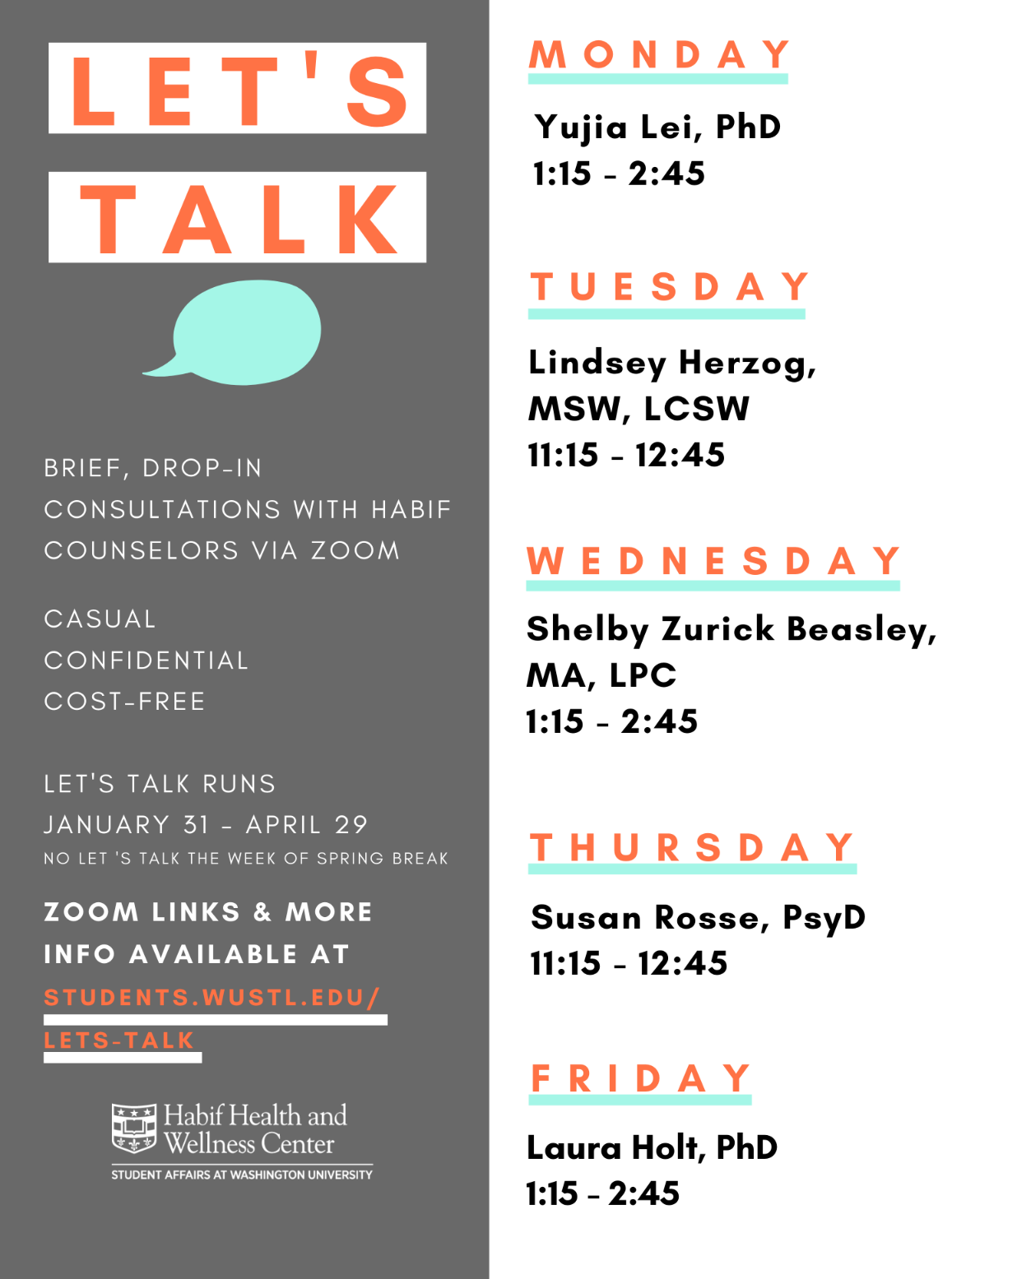
Let’s Talk find the zoom link via: https://students.wustl.edu/lets-talk/
Notes:
Chat with a counselor at one of many free, drop-in sessions throughout the week.
Confidential, don’t need to sign up ahead of time.
Awesome for:
People who want to explore what therapy is like, but don’t want to commit to a session
If you want to talk about a friend
If you have a one-time concern
Sometimes, you need to talk with someone RIGHT NOW. This is why we have Let’s Talk. 7 different times during the school week, counselors are placed around different locations on campus for free, drop-in, confidential consultations. We do have a location at the Law School on Thursdays, although you’re welcome to attend any session on campus.

Slide 15
Questions?

Slide 16
McKelvey DEI Committee

Slide 17
Committee Timeline 2021
Members Recruited: Jan/Feb, 2021
Initial Charge Defined: Jan/Feb 2021
Summit/Retreat: Early March, 2021
Current Climate: Late March, 2021
Best Practices and Outcomes: Late April, 2021
Initial Recommendations to Dean: Late May, 2021
Prioritization and Synergy: Late Sept, 2021
Guiding Principles: Late Dec, 2021

Slide 18
Initial Committee Leadership
Chair, Princess Imoukhuede
Director of Diversity Initiatives
Associate Professor,
Biomedical Engineering
Associate Chair, Jessica Wagenseil
Vice Dean for Faculty Advancement
Professor,
Mechanical Engineering and
Materials Science

Slide 19
Committee Members
Students | Staff | Non-TT Faculty | T/TT-Faculty
Kelechi Achilefu BS MEMS | Kris Campa Asst Dean Student Services | Tsitsi Nussinov Lecturer ESE | Damena Agonafer Asst Prof MEMS
Hannah Smith BS ESE | Justine Craig-Meyer Sr Assoc Dir Advancement | James Orr Lecturer CSE | Marcus Foston Assoc Prof EECE
Liz Chaparro BS/MS ESE | Jamie Hendrix Office Manager UMSL Program | Sandra Matteucci Sr Lecturer Communication Center | Jon Silva Assoc Prof BME
Dinal Jayasekera PhD BME | Ariana Jasarevic Staff Specialist Human Resources |  | Michael Brent Prof CSE

Slide 20
Initial Committee Charge
To exemplify, encourage, facilitate, and nurture a culture of inclusive excellence at the McKelvey School of Engineering through the identification and implementation of the best practices in recruitment, retention, and climate for students, postdocs, faculty, and staff of Black, Indigenous, and Latinx populations.

Slide 21
Committee Working Groups
Working Group
1. Student Education + Curricula Change
2. Faculty and Staff Education + Bias Reporting
3. Office for Minority Students and Postdoctoral Fellows
4. Staff
5. Faculty
6. Initiatives + Info repository dissemination
7. K-12 + Alumni/Industry

Slide 22
Committee Timeline 2021
Members Recruited: Jan/Feb, 2021
Initial Charge Defined: Jan/Feb 2021
Summit/Retreat: Early March, 2021
Current Climate: Late March, 2021
Best Practices and Outcomes: Late April, 2021
Initial Recommendations to Dean: Late May, 2021
Prioritization and Synergy: Late Sept, 2021
Guiding Principles: Late Dec, 2021

Slide 23
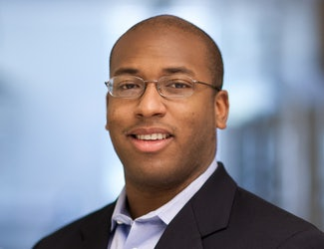
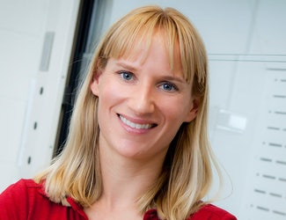
Current Committee Leadership
Chair, Marcus Foston
Director of Diversity Initiatives
Associate Professor,
Energy, Environmental, and Chemical
Engineering
Associate Chair, Jessica Wagenseil
Vice Dean for Faculty Advancement
Professor,
Mechanical Engineering and
Materials Science

Slide 24
Committee Timeline 2022
Refine Guiding Principles: Jan/Feb, 2022
Reorganize Working Groups: Mar 2022
Develop Committee Charter: Apr 2022
Write Strategic Plan: July, 2022

Slide 25
Guiding Principles (in progress)
A commitment to a culture and climate in which all students, faculty, and staff feel welcome and respected, despite forms of difference, is critical for institutional excellence and distinction.
DEI requires transformation of both individual values, beliefs, and behaviors and institutional policies
Recruitment, retention, and success of underrepresented students, staff, and faculty is a cornerstone of addressing the lack of diversity within the academic and professional communities.
Practices and educational opportunities create awareness, appreciation, acceptance, and celebration of different cultures, beliefs and ideas.

Slide 26
Committee Working Groups
Working Group
1. Student Education and Curricula Change
2. Staff
3. Accountability Systems – Driving Change
4. Incentive Systems – Facilitating Change
5. Relational and Communication Systems – Encouraging and Signaling Change

Slide 27
DEI Strategic Plan (just starting)
Based on guiding principles
Consistent with WUSTL strategic plan
5 year timeline of initiatives to drive, facilitate, encourage, and signal change for staff, faculty, and students

Slide 28
Ariana Jasarevic
Update on DEI Staff Working Group
Promotion for development, coaching, and learning

Slide 29
McKelvey DEI Committee
Marcus Foston
Charge: This process and working group is meant to generate a list of initiatives to be the starting position for a strategic plan in regards to hiring, retention and success of staff within DEI.
Staff Working Group
Meghann Pytka
Jesi Hempstead
Chiamaka Asinugo
Jon Silva
Ariana Jasarevic
Staff Focus Group 1
Held on 3/2/2022
Hiring Managers Focus Group (4/4/2022)
Staff Focus Group 2
TBD (please email any of us if you’d like to participate)

Slide 30
Other updates:
April Manager ELG - How to Have Impactful Conversations During Annual Reviews (in-person)
Day of Dialogue & Action - March 30th @ 2:30 Why Do We Need a WU Equity and Inclusion Council? Breaking Out of the Demand–Response Loop
Notes:
The Day of Dialogue and Action (DoDA) is Washington University in St. Louis’ dedicated time for its community to pause, convene and engage across roles and campus locations. The event helps build meaningful connection as faculty, students and staff reflect upon our shared values and lived experiences.

Slide 31
Peak Performance/Flow Coaching - Available to all staff - Reach out for an immersion session.
Benefits of flow:
-lower burnout, more productive, feel better
-subtractive approach to being at work, prioritization, delegation
-emotional regulation, positive psychology focus, cognitive behavioral coaching
-neuroscience based

Slide 33
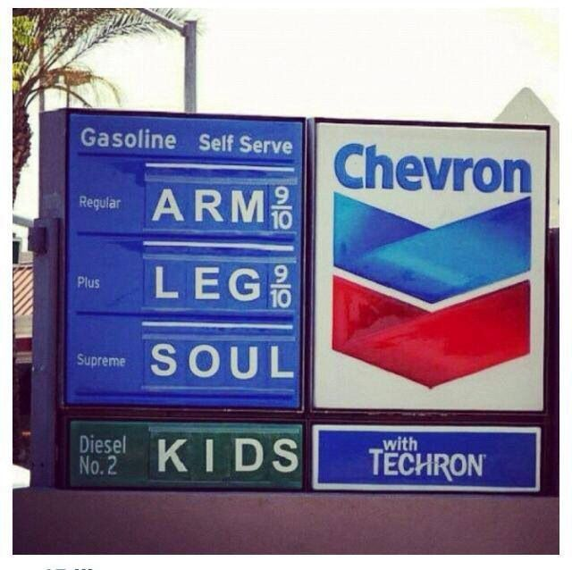
Ditch your yellow/red permit to save HUNDREDS to THOUSANDS!
It all adds up…
$852 annual Danforth yellow permit (FY22)
View all permit prices.
$200-$1,500+ in gas
Car depreciation
Car maintenance
Low-mileage car insurance (possibly)
Notes:
After all of those variables are taken into account, all your driving expenses could be well over $1,000. Is it really worth it?
Is it really that much more convenient as some of your alternatives?

Slide 34
What would you do with the extra money?
Notes:
Whether it’s an extra vacation, upgraded vacation, new things for your house or simply building your savings, it’s easy to save an extra $700 to a few thousand!

Slide 35
Do it for your health & wellbeing!
Get to work with more energy & less stress
Less driving in traffic = reduced negative health effects of stress
Work towards your 150 mins of moderate aerobic activity a week
Traveling by public transportation is safer per mile than traveling by auto
Carpoolers tend to rate their commutes as less stressful
Contribute to a more sustainable environment
Notes:
Instead of sitting your entire commute just to sit throughout your workday, you can add some extra activity into your day.
Adults should get at least 150 minutes of moderate aerobic activity a week.
Includes brisk walking.
Add some extra walking and/or biking into your commute!
Only 21% adults meet the CDC’s Physical Activity Guidelines.
Sitting for long periods of time is linked with many health issues.
Sitting for long periods of time is linked with a number of health issues.
Add some extra walking and/or biking into your commute…instead of sitting in a car all the way to your front door.
Does anyone go to a gym to use a cardio machine? You can easily incorporate exercise into your daily commute!
Obesity, high blood pressure, high blood sugar, excess body fat around the waist, high cholesterol levels and more.
Increased risk of death from cardiovascular disease and cancer.
Public transit is safer than driving.
A healthier environment = healthier communities!
By limiting your driving, you can help protect the environment and the community’s health by reducing toxic emissions.

Slide 36
You don’t have to completely give up your car
& there are support programs available!
Notes:
These support programs make it more convenient to use an alternative method, especially when you use a variety of methods .
You don’t have to completely give up your car!
Numerous options for when you’re unable to use an alternative method.

Slide 37
Ride matching & trip planning platform
Search for a WashU carpool or bikepool partner
Based on your schedule, route and preferences
Contact them directly through the platform
View an interactive transportation map
Explore transportation-related items, like carpool commuter lots, bike paths, Metro stops touching Danforth, WashU shuttle routes/stops, and much more
Log your trips
Track how much money and CO2 you've saved, how many calories burned, and how many miles you've traveled via sustainable transportation
Participate in challenges to win prizes
Active Transportation Month’s commuter challenge is in April
And many more features/tools
Please spread the word about WashU Rides
The more people using it, the better the matches will be

Slide 38
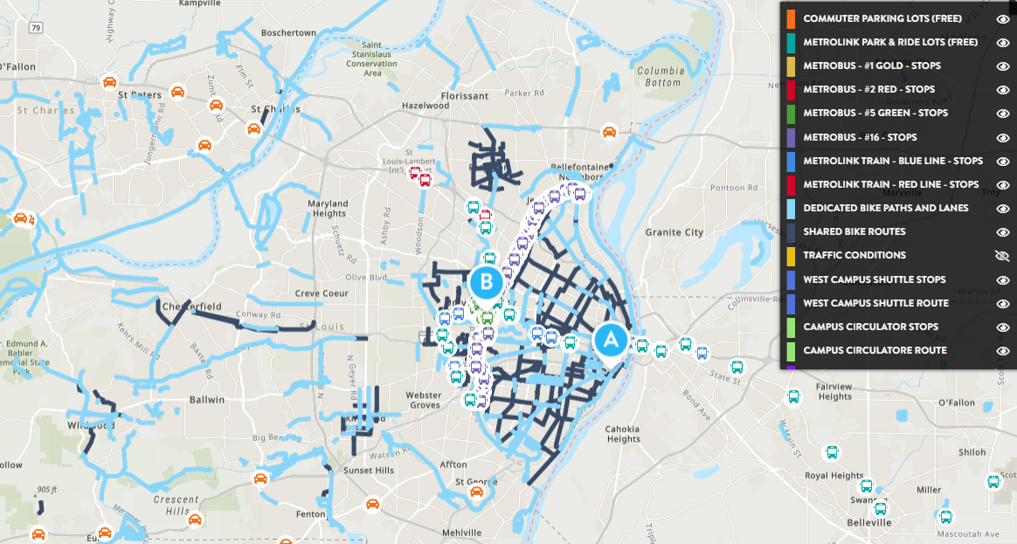
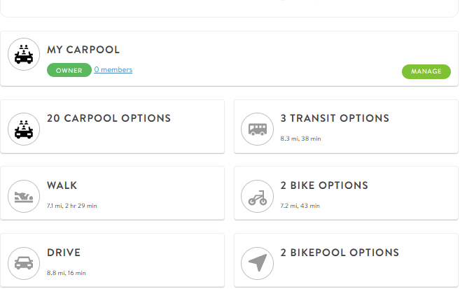
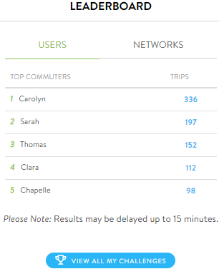
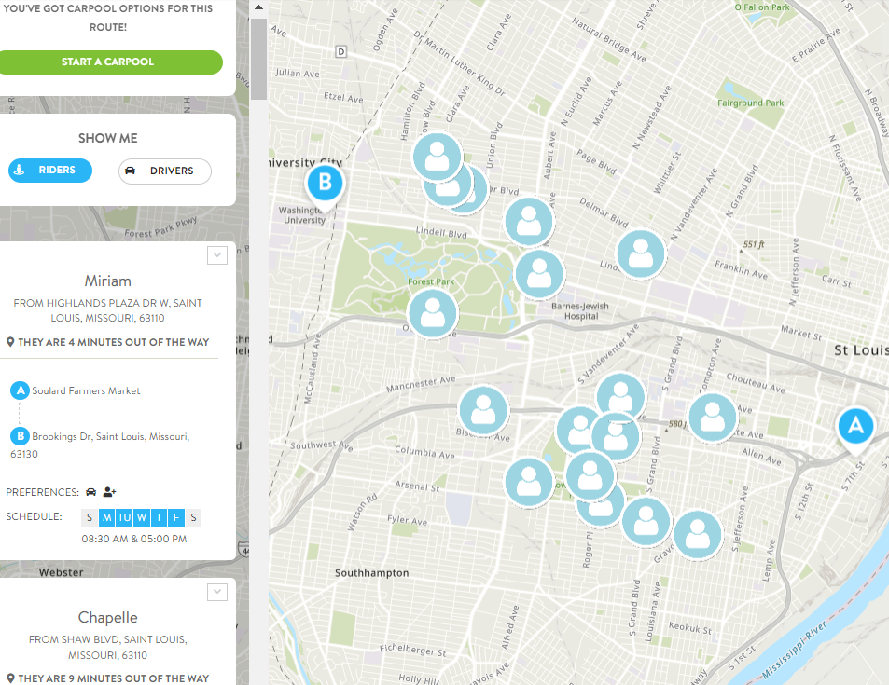
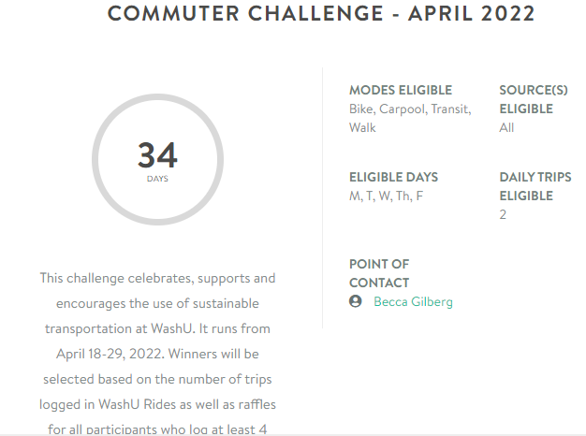
WashU Rides - examples of some features & tools
Interactive Map
Personal Commute Options
Carpool matches

Slide 39
Guaranteed Ride Home
Get a ride home in the case of an emergency (up to 4 per year).
Metro, walking & biking - Citizens for Modern Transit:
Reimburses 80% up to $60.
Bearly Drivers carpool members - RideFinders:
Covers 100% up to $125.
Register for free online.
Learn more here.
Notes:
Guaranteed Ride Home is a terrific program that will cover most, if not all, of your costs for getting home via cab or car rental in the event of sickness (includes immediate family), unscheduled overtime (Working late with at least one day prior notice), or a personal/family emergency.
Citizens for Modern Transit (Metro, walking and biking):
Reimburses 80% of your cab or enterprise car rental costs up to $60 .
Approved emergencies: sickness, unscheduled overtime and personal/family emergency.
If using enterprise, enter CMT’s discount code on their website.
Before submitting the receipt for reimbursement, must have me sign off on the receipt validating the reason for the emergency ride home.
Travel is restricted to the following designations and uses:
The trip must begin at the employee’s official worksite and can end at the person’s home or, in special cases, another location.
Emergency related interim stops would be permitted if necessitated by the type of emergency.
If using a rental car, the car can be kept overnight and returned the next day.
You pay for the cab or car rental – save your receipt and submit a request for reimbursement.
RideFinders:
FREE rides home (up to $125).
Join the Bearly Drivers Program, and I’ll sign you up automatically.
Contact me as soon as you find out about your emergency so I can arrange your ride.
Reasons:
Unscheduled overtime, sudden illness or emergency,
early daycare/school/work release
unanticipated absence of driver or vehicle

Slide 40
Occasional Parking Program
Supports people who use sustainable transportation as their main commute method (Bearly Drivers excluded)
For the OCCASIONAL days you want to park on campus, enjoy 50% off visitor parking rates
Up to 480 hours annually (counted in 2-hour intervals)
Sign up as soon as possible since these fill up quickly
Visit the Occasional Parking Program page for more details
Notes:
This is a great program for people who use alternative transportation and need or want to occasionally park on campus.
50% off daily permits ($2.50/each) for when you need to park on campus.
$20 for a pack of 8 daily permits.
Part-time = buy 3 packs per year
Full-time = buy 6 packs per year
You’ll get a membership card that’ll get punched each time you buy a pack of permits.
Park in yellow zones, but not DUC.

Slide 41
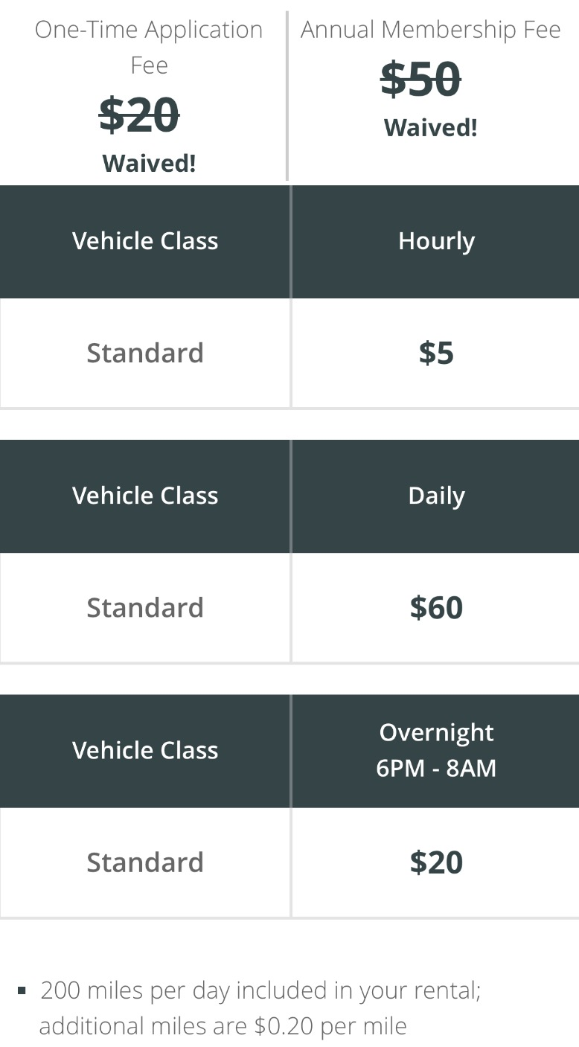
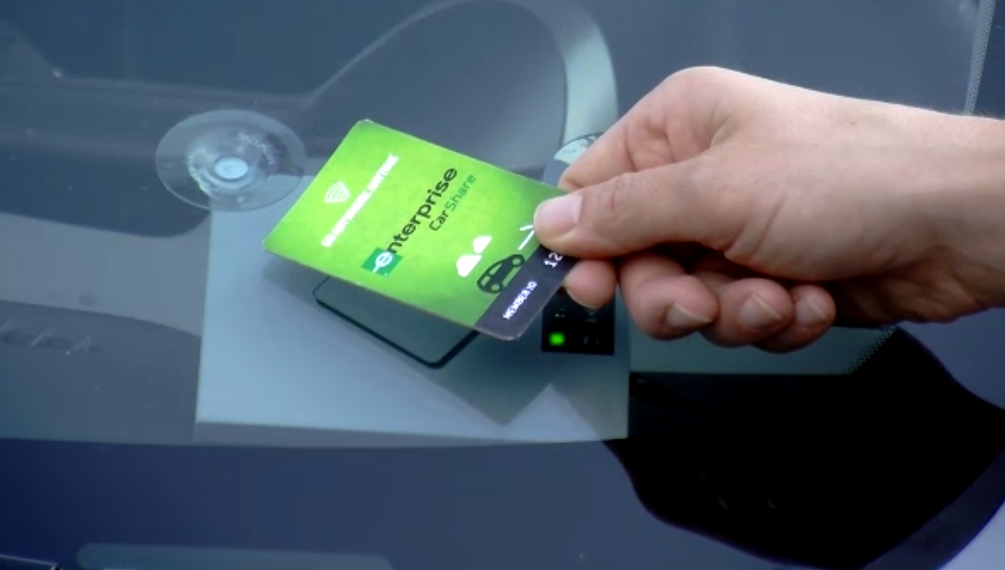
CarShare Rent a car 24/7 for $5/hour from designated spots on campus!
Make a reservation online or via the app
Reserve as far in advance as possible to ensure availability
FREE gas (Up to 200 miles/day)
Physical Damage/Liability Protection included
24/7 Member Services & Roadside Assistance included
Department accounts are available
Learn more and sign up here.
Review the Member Policies for important info.
Access cars using your membership card. Reservations required.
Notes:
Leave for lunch, head to meeting or appointment, run errands…whatever you need!
Rent a car 24/7 from many designated spots across campus!
WashU charges less than many. Webster is $12/hour with a $35 annual membership fee, Maryville is $8/hour with $35 membership fee and SLU is 7/hour, its $9 if you rent one that isn’t through a university
No fuel costs
Up to 200 miles per day included with additional miles $.20/mile vs other universities that charge $.45 per mile
Physical Damage/Liability Protection included
24/7 Member Services & Roadside Assistance included
No registration fee (usually $20)
No annual fee (usually $50)
Rates:
$5 an hour
$20 overnight (6pm – 8am)
$60 full day
Apply for a membership online.
Get membership materials, including smart card.
Reserve a car through their app, online or by phone.
Choose the car/ location and time you want.
Hold your smart card over the reader to get in and go!
Return to the same spot.

Slide 42
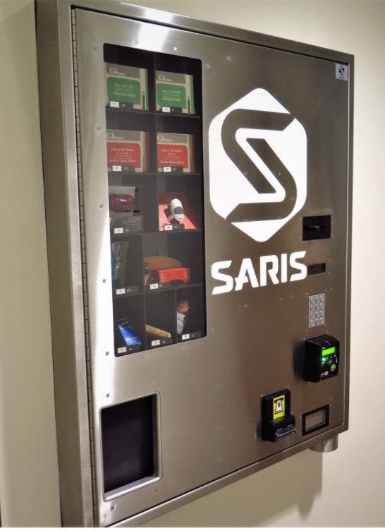
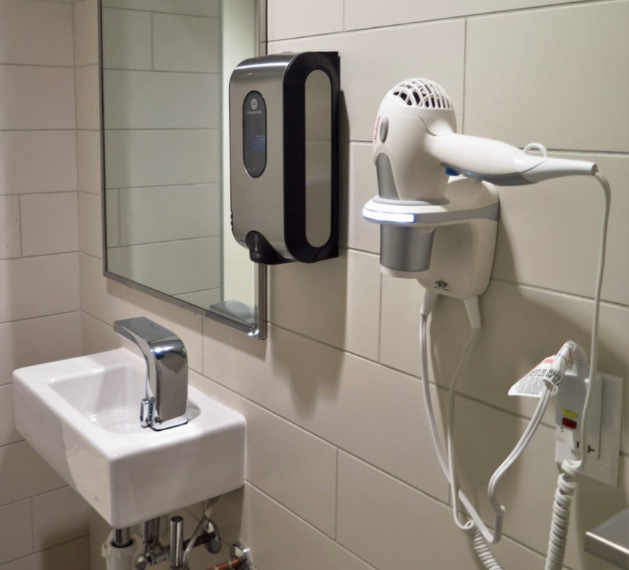
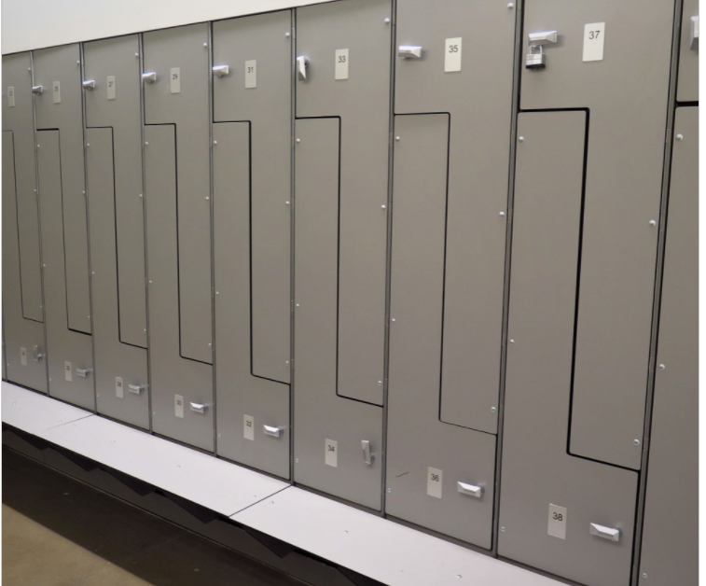
Active Commuter Hub in the Schnuck Pavilion
Commuter Hub is available only to members with card access
Entrance to the Hub as well as private showers requires card access
Limited memberships available
Shower stalls - all private & require card access
Include a sink, hair dryer, bench, hair & body wash, mirror and hooks
Cubby-style lockers for daily use
Reserved Z-style lockers
Reserved for additional fee
Bike Parts Vending Machine
Membership prices per semester:
$20 Basic - showers and daily cubby locker
$40 membership + reserved Z-style locker
Fall, Spring & Summer memberships

Slide 43
YOU HAVE OPTIONS

Slide 44
Bearly Drivers Carpool
Drastically reduced carpool permit – per person monthly cost based on # of carpool members:
$8.33 for 4 members
$15 for 3 members
$22.50 for 2 members
Designated parking spaces
No more searching for a spot!
FREE Guaranteed Ride Home.
4 free (up to $125) rides home per year in case of emergency.
1 FREE validation permit per month per person.
Use WashU Rides to view commuter lots as well as search for carpool matches based on route, schedule & preferences
Carpool matches
Notes:
Drastically reduced permit costs for members:
$150 per person for 2 member carpools ($300 total).
$66.66 per person for 3 member carpools ($200 total).
$25 per person for 4 member carpools ($100 total).
2 FREE daily permits per month for non-primary drivers.
Enrolled in the Guaranteed Ride Home program.
Reserved Bearly Drivers spots until 2 pm.
These spots are on a first-come, first-served basis and are located in spots closer to each building.
Enrolled in the Guaranteed Ride Home program.
Once you’re a member I’ll automatically enroll you.

Slide 45
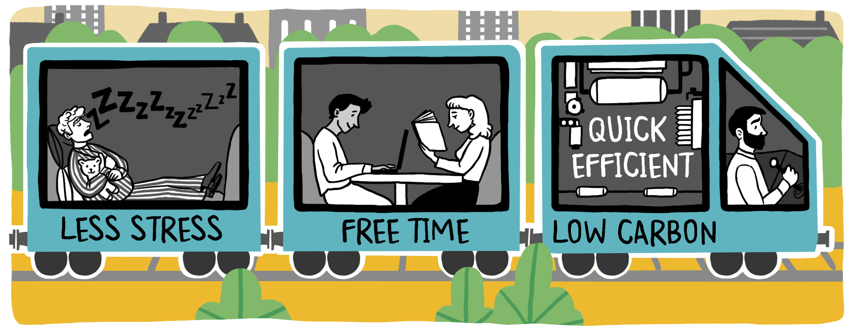
Metro: You Can Do It!
FREE for benefits-eligible faculty/staff & full-time students
Request Metro U-Pass online
MetroLink stations on Danforth (at Skinker & Big Bend), North, West and Med Campuses
Park & Ride lots if you don’t live near a stop
Park at a train station and commute directly to campus
Bike & ride - Bring your bike on the train/bus
Use along with WashU’s transportation support programs

Slide 46
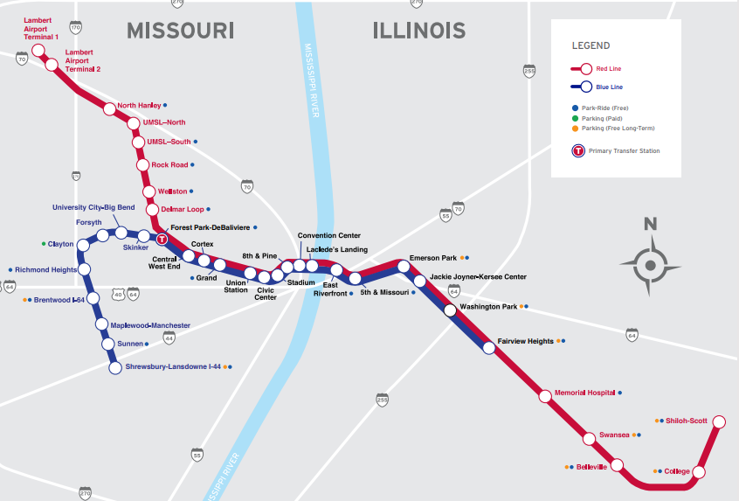
MetroLink Stations and Park & Rides

Slide 47
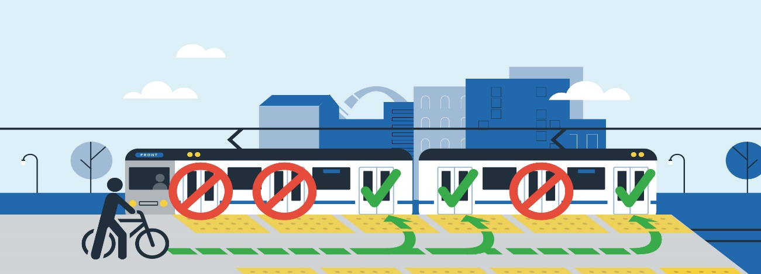
Cycling
FREE bike registration for Danforth employees/students
Buy a discounted Kryptonite U-Lock from WUPD
Free bike events, maintenance tune-ups, workshops, bike rides, giveaways and more during Active Transportation Month (ATM)
ATM is every April & October
Campus Fix-It stations for basic bike maintenance/repairs
Pass people/bikes on the left.
Alert people with “on your left” and/or a bike bell.
Go multimodal & bring your bike on the train or bus!
“. . .I rode my bike to work today. You gave me just the push I needed to try it. I was able to make it to work in the same amount of time it took me in a car yesterday, due to the flow of traffic. . .” - Jena
Notes:
Free escort to or from any location on campus.
8 p.m.-2 a.m. during the academic year.
Ample paths that are both designated bike paths and shared.
Centennial Greenway: Forest Park through campus, along Kingsbury Avenue to Delmar Boulevard, north to Vernon.
Wydown: dedicated bike paths both ways
Bikes are allowed on the Metro.
Ample paths to get you to campus, around campus and home.
TONS of bike racks around campus, including many covered racks.
Fix-It Stations for bike maintenance and repairs.
You can go to any of these to air up your tires.
U-Lock available for reduced price ($20).
Register bike with WUPD to improve chance of recovery if bike is stolen.
This is a small portion of a map from Great River Greenways.
This can help people determine the best bike routes to campus.
The two paths that I think are the most convenient for the Wash U community are the Centennial Greenway and the bike path along Wydown.
The Centennial Greenway goes from Skinker Boulevard and Forsyth Boulevard at Forest Park up through Danforth Campus, along Kingsbury and then up past Delmar.
There are dedicated bike lanes on both side of Wydown from Wydown and Edgewood to Forest Park.

Slide 48
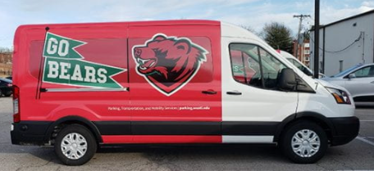
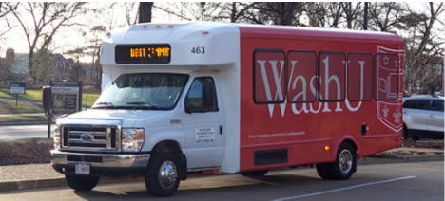
WashU Shuttles
Numerous WashU shuttles that serve Danforth campuses and surrounding neighborhoods
Visit shuttle page to view all routes, schedules and more
Check real-time shuttle locations on the WashU Mobile App
Stay updated on campus shuttle alerts & changes:
For urgent alerts, like last-minute re-routes and delays, sign up for text alerts by texting “WUSHUTTLES” (case sensitive) to 888777
Subscribe to the shuttle email list for non-urgent shuttle updates

Slide 49
Want to learn more?
Check out our smart commute page to learn more about sustainable transportation options, support programs
and tips/resources.
parking.wustl.edu/smartcommute
Becca Gilberg
Sustainable Transportation Coordinator
Parking & Transportation Services
rgilberg@wustl.edu
Parking questions:
parktrans@wustl.edu
314-935-5601

Slide 50
SUSTAINABILITY AT WASHU VISION 2030
Highly ambitious targets are an essential step in addressing climate change, biodiversity loss, and global pollution with the sense of urgency that science suggests is required to limit the devastating impacts on human and environmental systems.

Slide 51
DEFINITIONS OF SUSTAINABILITY
Sustainability is the ability to meet the needs of the present without compromising the ability of future generations to meet their own needs.
United Nations World Commission on Environment and Development
Sustainability is the capacity to improve the quality of human life while living within the carrying capacity of the Earth’s supporting eco-systems.
International Union for Conservation of Nature
The Office of Sustainability advocates for policies and practices that maximize and value social, environmental and financial outcomes.

Slide 52
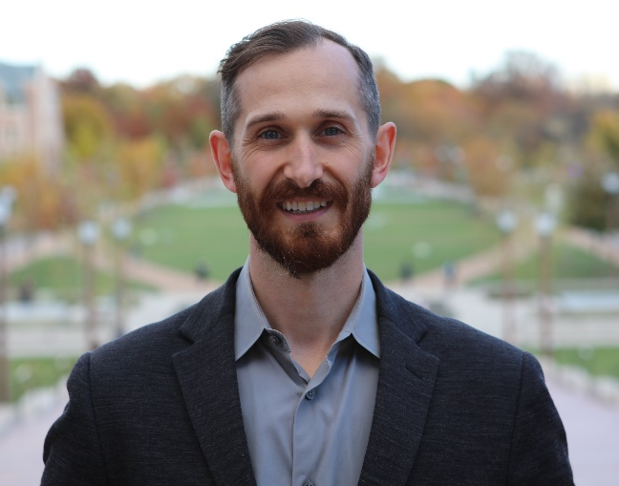
Office of Sustainability
Aamna Anwer
Sustainability Coordinator
Alternative transportation, food systems, communications, student collaborations
Cassie Hage
Assistant Director
Waste management, sustainable purchasing, campus culture change, emergent opportunities, green events & green offices
Michelle Patterson
Internship Coordinator and Business Manager
Internship program coordination, project and event support, business manager
Phil Valko
Assistant Vice Chancellor for Sustainability
Strategic planning, university policy, carbon reduction, faculty partnerships, community partnerships

Slide 53
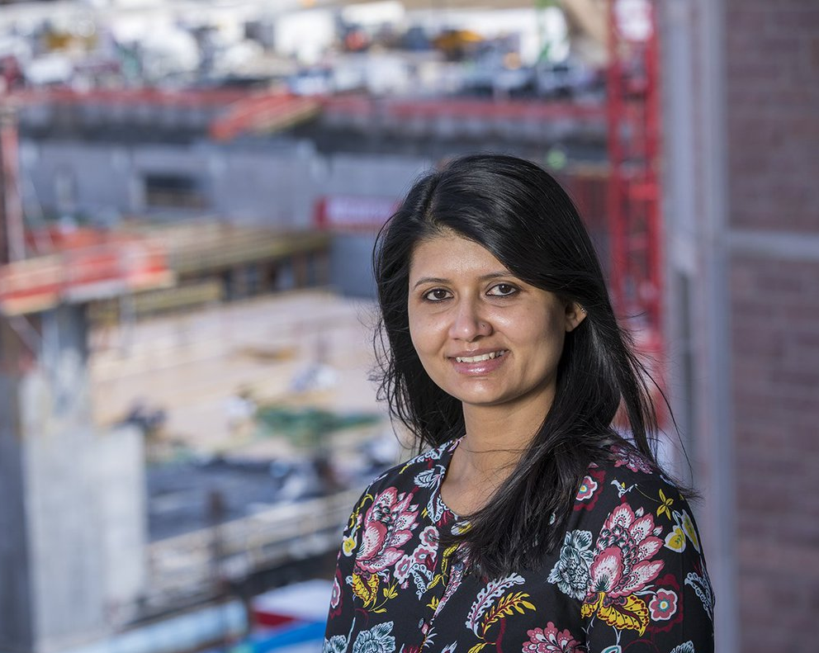
Embedded Staff/Extended Circle
Heather Craig
School of Medicine Sustainability Coordinator
Dedicated sustainability staff member on the School of Medicine Campus for related programming and strategic planning. Reports through Med School Facilities.
Alicia Hubert
Relocation Space and Equipment Planner & Sustainability Program Leader
Lab equipment planning & green lab integration for the Neuroscience Research Building. Leads WUSM sustainability program and green lab program, Med School Facilities.
Railesha Tiwari
Sustainable Design and Construction Project Manager
Green buildings, including development of campus standards, integrated design process, project-specific goal setting, LEED oversight

Slide 54
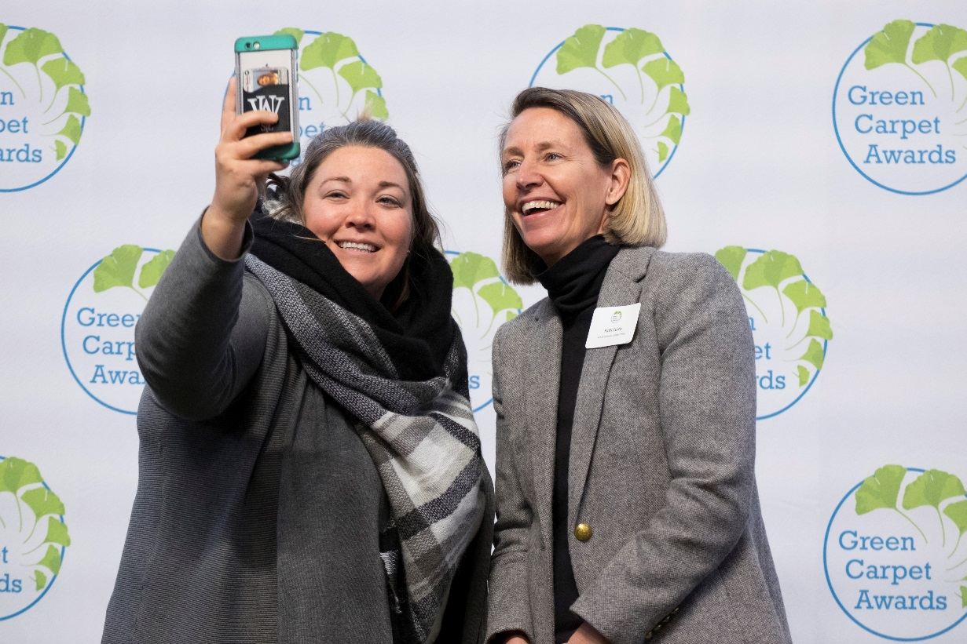
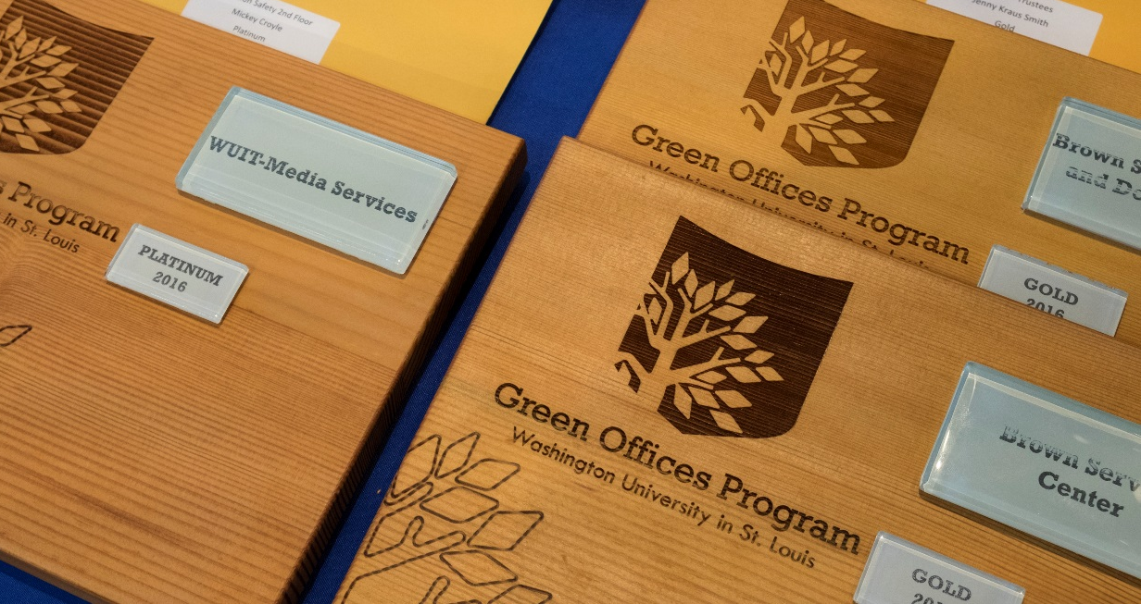
The Green Office Program
The Office of Sustainability

Slide 55
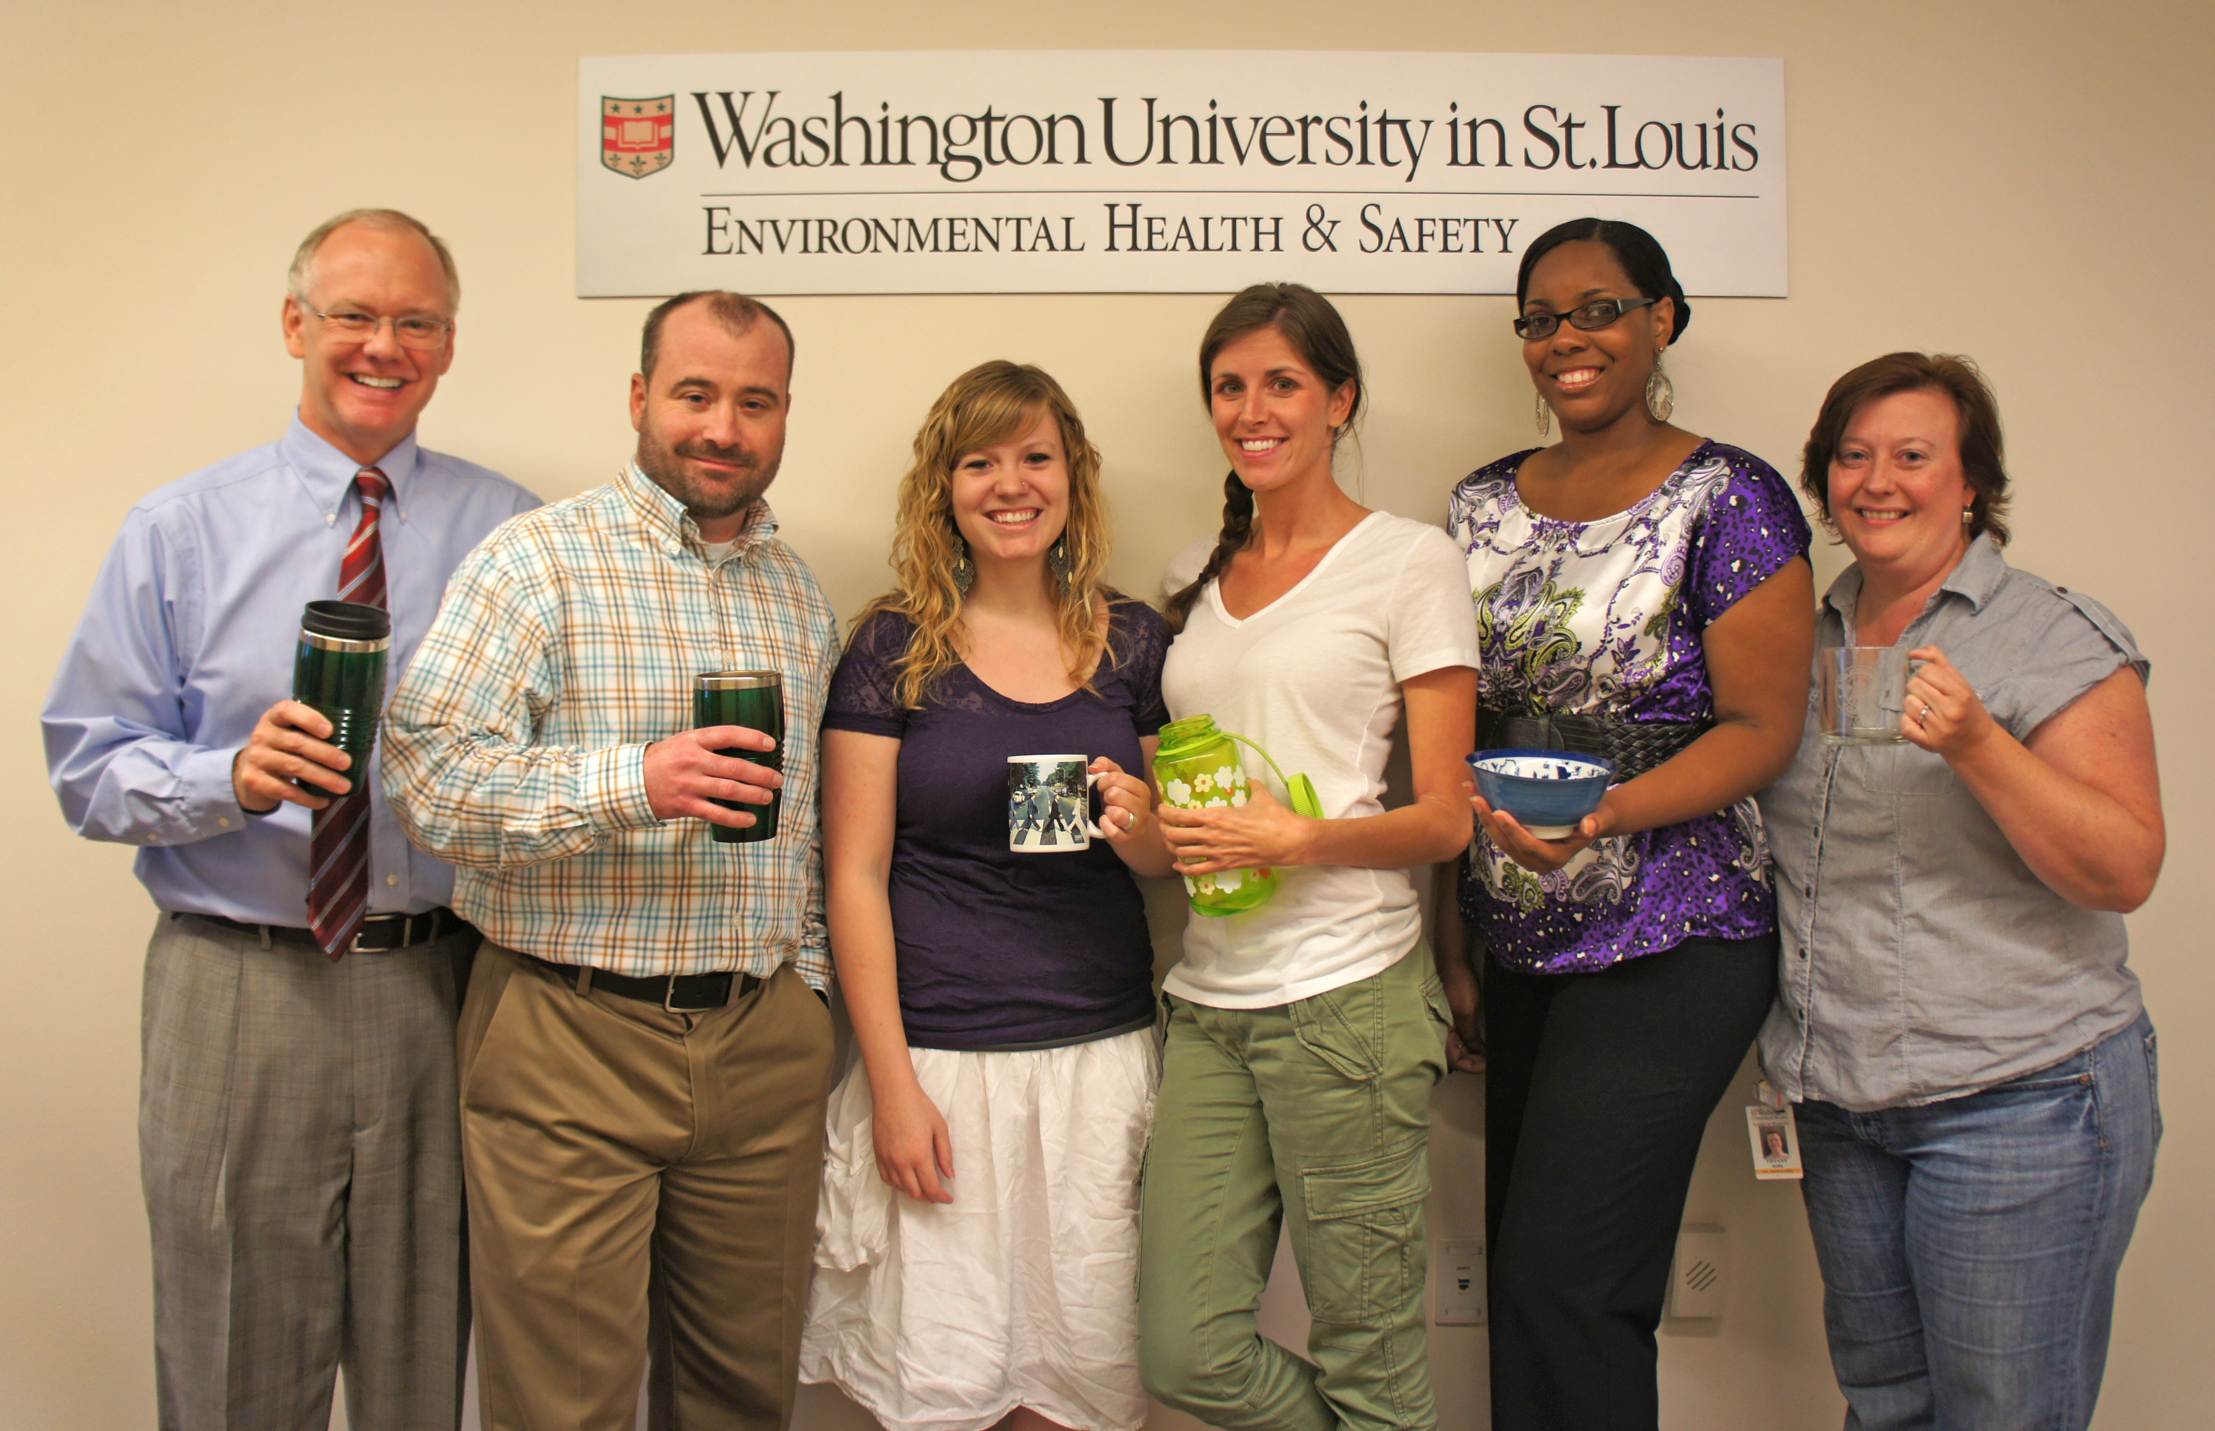
What is The Green Office Program?
The Green Office Program is a framework and set of resources meant to empower offices to reduce their environmental impact on campus through a self- assessment checklist that helps offices evaluate their practices, set goals, and be recognized for their sustainable practices.
Notes:
This program is meant to empower office teams to reduce their impact and costs through a self- assessment checklist with 7 categories that offices use to evaluate their current practices, set goals, and be recognized for their sustainable practices
It aims to encourage offices across all WashU’s campuses to be champions of our university’s sustainability ethic

Slide 56
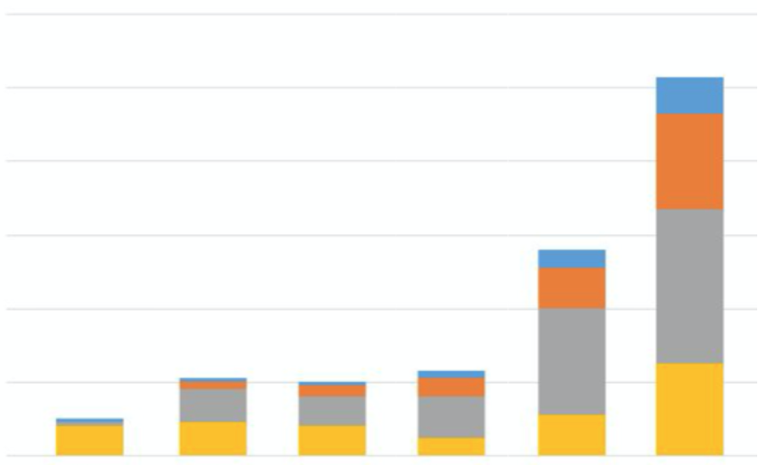
Program Goals
Green Office Participants
Major impact through cumulative effort
Engagement on all WashU campuses
Bring Sustainability Strategic Plan to life
Build a sustainable community
Over 115 offices are currently certified
120
100
80
60
40
20
0
2012
2013
2014
2015
2016
2017
Bronze
Silver
Gold
Platinum
Notes:
The Green Office Program aims to encourage offices across WashU’s campus to be champions of our university’s sustainability ethic
We have proudly certified over 113 offices
In 2017, we exceeded our goal of certifying over 100 offices!
Now in the process of certifying and re-certifying offices for 2022

Slide 57
Key Components
SELF- ASSESSMENT
PROVIDES RESOURCES
GOAL- SETTING
Notes:
The checklist allows offices to evaluate their current practices, learn more about other sustainable practices, and set new goals.
Self- assessment: The checklist serves as a self- assessment to help offices gage where they stand in their own sustainable practices. There is no auditing, checklist is to help offices self-evaluate.
Provides resources: The checklist provides resources for each checklist category for information about topics as well as links to guides, instructions and specific policies. More resources can also be found on the Sustainability website and newsletter.
Goal- setting: The checklist ends with a goal worksheet to encourage ways for office improve for next certification. The worksheet encourages offices to fill out their goals and action plan and allows green office associates to provide recommendations.

Slide 58
Certification Levels
Bronze
Silver
Gold
Platinum
50-64%
65-79%
80-89%
90%+
Notes:
Certification broken down into 4 levels of recognition depending on grand total percentage that has been automatically calculated after completion of the checklist
As offices reach certain milestones, they become a “certified green office” at Bronze, Silver, Gold and Platinum levels
After completing checklist, the OOS will confirm your certification level and which can always be resubmitted to achieve a higher level of certification

Slide 59
Checklist Categories
ENERGY
WASTE
DOCUMENTS
PURCHASING
TRANSPORTATION
AWARENESS
INNOVATION
Notes:
- The checklist is divided into the 7 categories of energy, waste, documents, purchasing, transportation, awareness and innovation

Slide 60
P12: Green Catering
For meetings and events with catered food, use a vendor certified with the Green Dining Alliance
Look through the list of recommended caterers for WashU events here.

Slide 61
W1: Community or Hanging Trash Bins
Remove individual bins in favor of community or hanging landfill ones
If you have to get up to throw away your trash, you’re more likely to make a conscious decision when sorting it
Office wide trash bins reduce the use of plastic liners
Reduce custodial costs and boost efficiency
Notes:
Liners: No bin liners will be provided. If individuals would like liners, they must bring their own bags from home. For messy landfill items, office members should use the common area landfill bin, which does have a liner.
Cleaning: Faculty and staff are responsible for emptying hanging bins into the common area receptacle and periodically cleaning the bins themselves, if necessary. Housekeeping will continue to service the individual recycling bins in each office as well as the communal landfill receptacle(s).
Purchasing: In exchange for returning all individual landfill bins, WUSTL Facilities Planning and Management will pay for and deliver the new hanging bins. The old individual bins will be warehoused by Facilities until a use can be found for them.
Enrollment: if you are on Danforth/North/West Campus, to enroll in the program, email Jan Schade at jschade@wustl.edu. If you are located at the Medical Campus, email Steve Smith at smithst@wusm.wustl.edu.

Slide 62
P11: Bottled Water
In the US, we use more than 50 billion plastic water bottles each year
38 billion end up in our landfills, oceans, and streets
Plastic bottles take hundreds of years to biodegrade
Encourage office members to bring their own reusable water bottle.
https://www.youtube.com/watch?time_continue=2&v=_6xlNyWPpB8

Slide 63
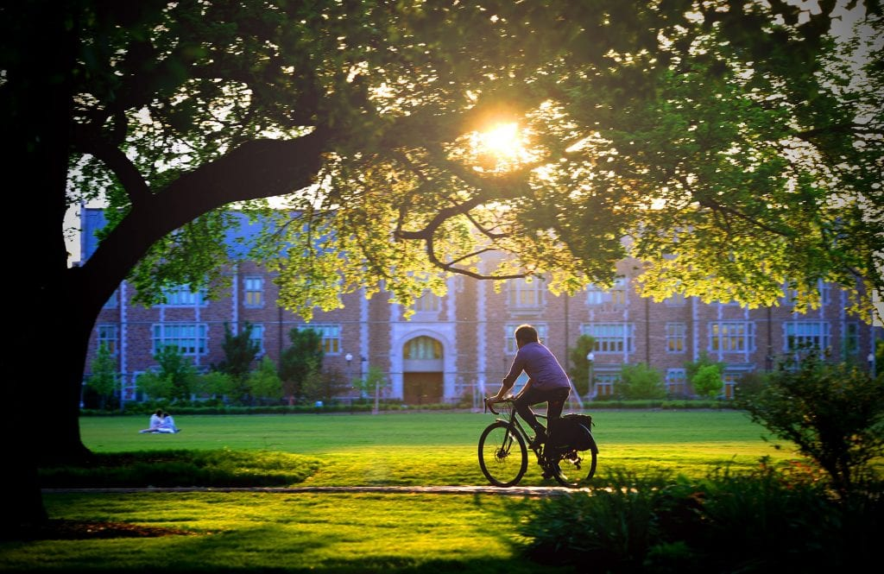
T1: Alternative Transportation
Through education and changes to policies and infrastructure, WashU works to advance low-carbon, active forms of transportation that lessen environmental impact, encourage healthy lifestyles, and strengthen our sense of community.
Notes:
Visit SmartCommute https://parking.wustl.edu/smartcommute/) to learn more about all the commuting services WashU provides to make it easier to save money using alternatives to a single occupant vehicle. (Promote the use of WashU Rides to connect with carpool buddies.

Slide 64
T3: U Pass
The U-Pass Program provides free Metro passes to Wash U faculty and staff
If an office member has a U-Pass and uses it once a month, your office will receive a point towards the checklist.
To register for a U-Pass, visit this website.
Notes:
Those who have a U-Pass are far more likely to use it intermittently than if they don’t have one! Once you get yours, if you are new to public transit, consider trying it to get to another campus or to a weekend excursion.

Slide 65
T7: Bearly Drivers Program
Full-time Danforth faculty and staff who meet all eligibility requirements may share the cost of a parking permit and park in designated Bearly Drivers parking spaces.
Encourage office members to arrange carpool systems to work to save time and money.
More information is available on the Bearly Drivers Carpool page.
Notes:
Coming soon: WashU Rides – a RideSharing program that matches potential carpool passangers/drivers.

Slide 66
T9: Enterprise Car Share
Enterprise, a car share service, increases convenience and reduces the number of vehicles on the road
Offices that have a Enterprise account for university business receive a point towards the checklist

Slide 67
A5: Green Monday Pledge
Our food choices have a major impact on public health and the environment.
The Green Monday Pledge is a commitment to eat vegetarian once a week.

Slide 68
Office Resources
Green Office Website
Green Office Newsletter
Print and Post Waste Signage
Request Signage and Resources
Green Office Presentations
Notes:
In addition to the resources linked in the checklist, The Office of Sustainability provides more resources on our website and newsletter
Further resources and signage can also be requested through the google form
The Office of Sustainability is available to support your certification process by providing this initial presentation, recommendations and facilitating goal setting. Green Office Associates are also available to answer any questions you may have!

Slide 69
Thank you for joining us!
McKelvey Staff Council

